Slide 1




FEATURES OF OUR SOLUTION
EMBEDDED
DEVICE TO MEASURE THE WATER LEVEL
DASHBOARD
SMS
SIREN

Slide 2
Overview
Inflow of data
Rain fall data
Outflow of Data
Water level detection
Flood control station
Rain-Run out relationship
Controlling of Gates
Situation is developing slowly and is under control. No danger
Blue Emergency
Situation is developing rapidly and failure is possible.
Orange Emergency
Failure is imminent or already in progress.
RED Emergency
Internal Alert
External Alert
Overall Alert

Slide 3
INTERNAL ALERT NOTIFICATION FLOWCHART
Site office of DAM
Owner/Operator
3
Office(s) of
Planning and
Design
Office of Executive
Engineer
1
2
Office of
Superintending Engineer
4
Office of Chief
Engineer
Office of Assistant
Executive
Engineer
Office of Assistant
Superintending Engineer
State Dam Safety
Office
5

Slide 4
EXTERNAL ALERT NOTIFICATION FLOWCHART
Site office of DAM
Owner/Operator
2
1
3
Office(s) of District
Collector
CWC Divisional Office
Office of Dam Executive Engineer
Critical Infrastructure Offices
(Powerplants,Roadways,
Railways ,Refineries, etc)
State Dam Safety
Office
CWC Regional
Headquarters
To Authority(s)
Present at the Downstream of Dam

Slide 5
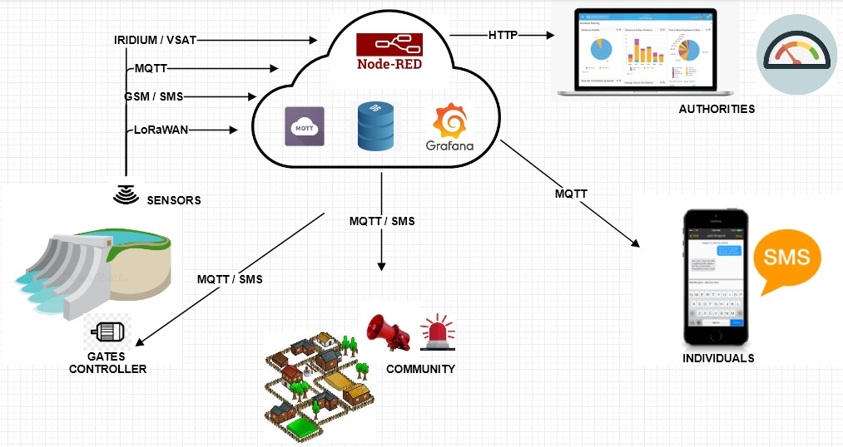
Inflow
Outflow
Rainfall
Water level

Slide 6
Work in progress
Rain-run relation ship (Algorithm):Ongoing
Data handling : Ongoing
Controlling of Gate with the acquired data : ongoing

Slide 7
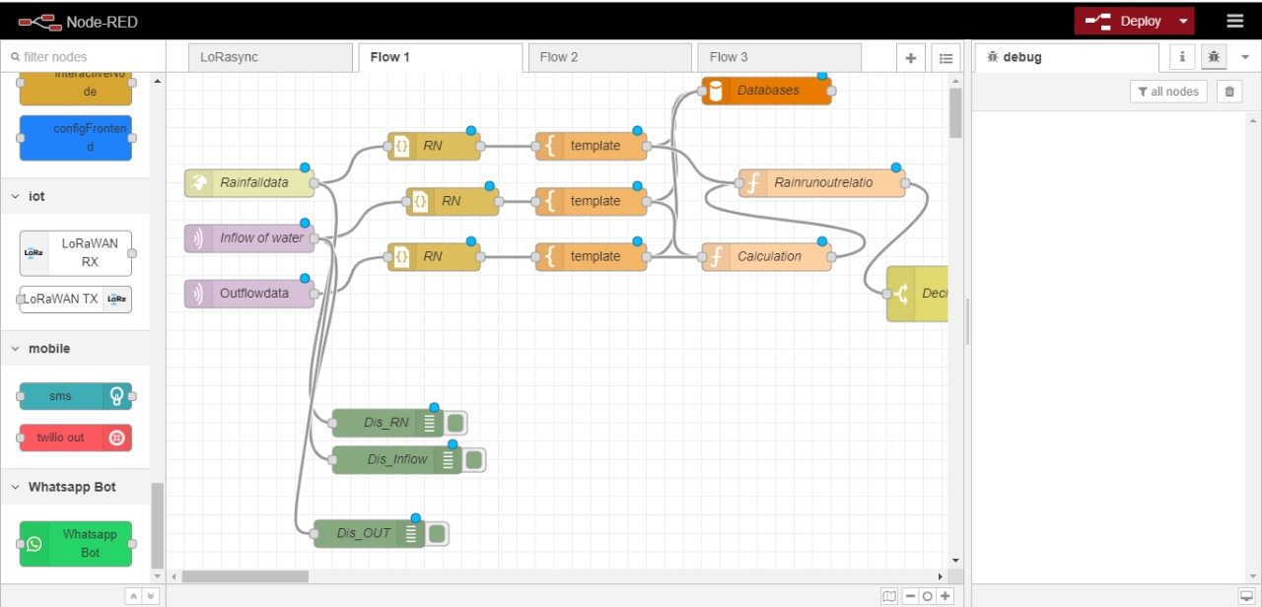

Slide 8
